Slide 1
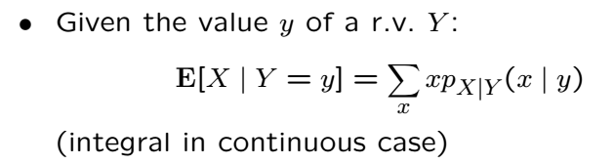
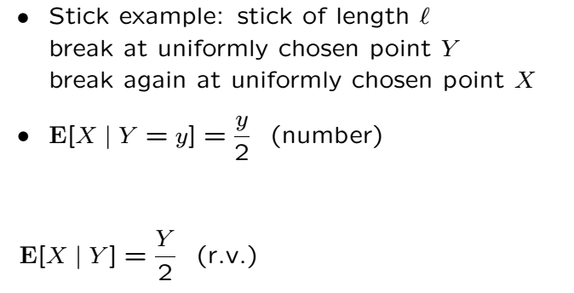
Conditional Expectation

Slide 2
Conditional Expectation
Conditional expectation of X given Y is a random variable!
Indeed, it is a function of Y
If X and Y are independent, it is a constant
Can be interpreted as an “estimator” of X given observation Y
This RV has a mean and variance (we will see more on this)

Slide 3
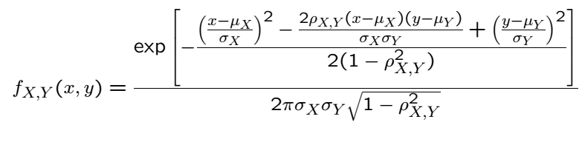

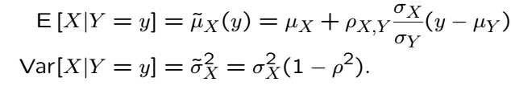
Gaussian Case

Slide 5
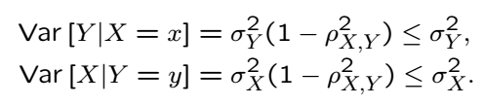
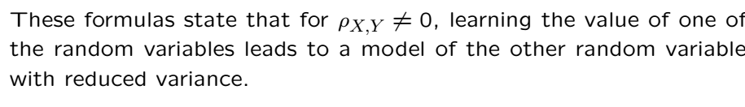
Gaussian Case Cont’

Slide 6



Iterated Expectations

Slide 7
Iterated Expectations Gaussian Example
What is the conditional expectation random variable?
What is the mean of this random variable?

Slide 8
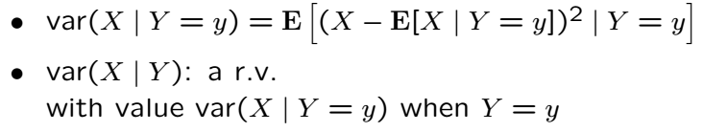

Conditional Variance

Slide 9
Stick Example
What is the conditional variance random variable?
What is the conditional expectation random variable?

Slide 11
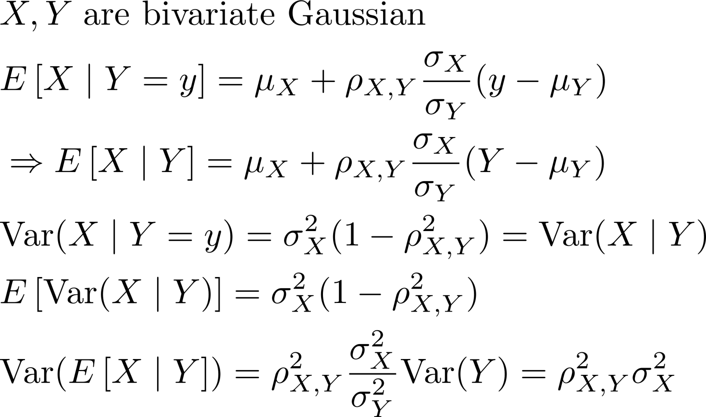

Gaussian Example
Sum of last two terms is like in formula

Slide 12
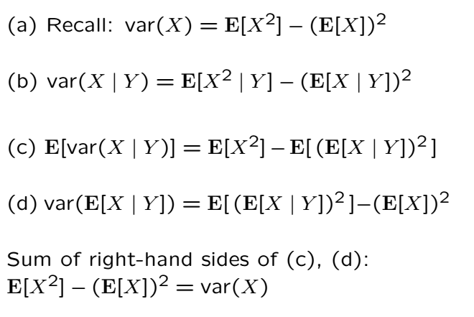
Proof

Slide 13
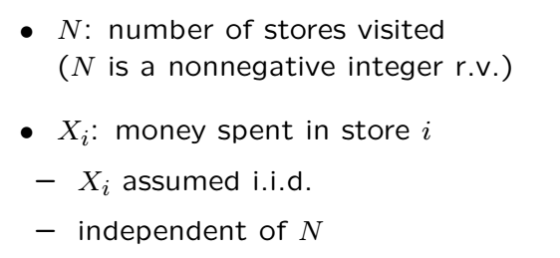

Sum of a Random Number of RVs

Slide 14
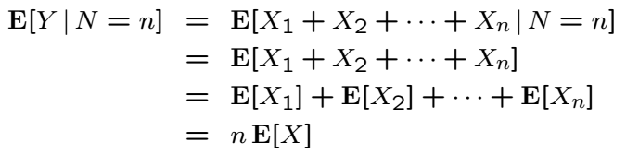

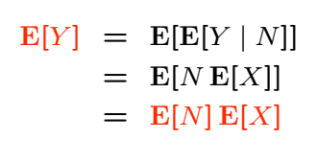
Sum of a Random Number of RVs Cont’

Slide 15
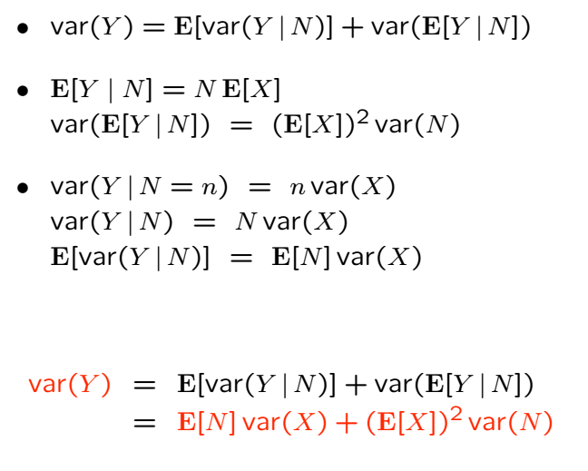
Variance of a Random Sum

Slide 16


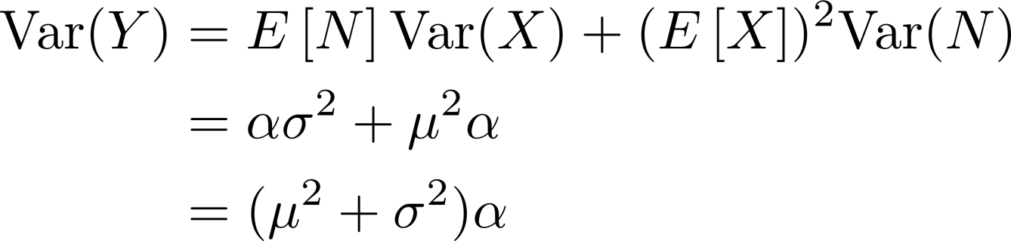

Poisson-Gaussian Example
The variance of random sum depends on

Slide 17
Acknowledgements and Citations
Parts of these slides are adapted from the following resources:
Power Point Lecture Slides for the Textbook http://bcs.wiley.com/hebcs/Books?action=index&bcsId=8676&itemId=1118324560
John Tsitsiklis. 6.041 Probabilistic Systems Analysis and Applied Probability, Fall 2010. (Massachusetts Institute of Technology: MIT OpenCourseWare),http://ocw.mit.edu (Accessed 13 Apr, 2015). License: Creative Commons BY-NC-SA

